Slide 2
Overview
My journey
Master thesis project
Why this lab?

Slide 3
My journey

Slide 4



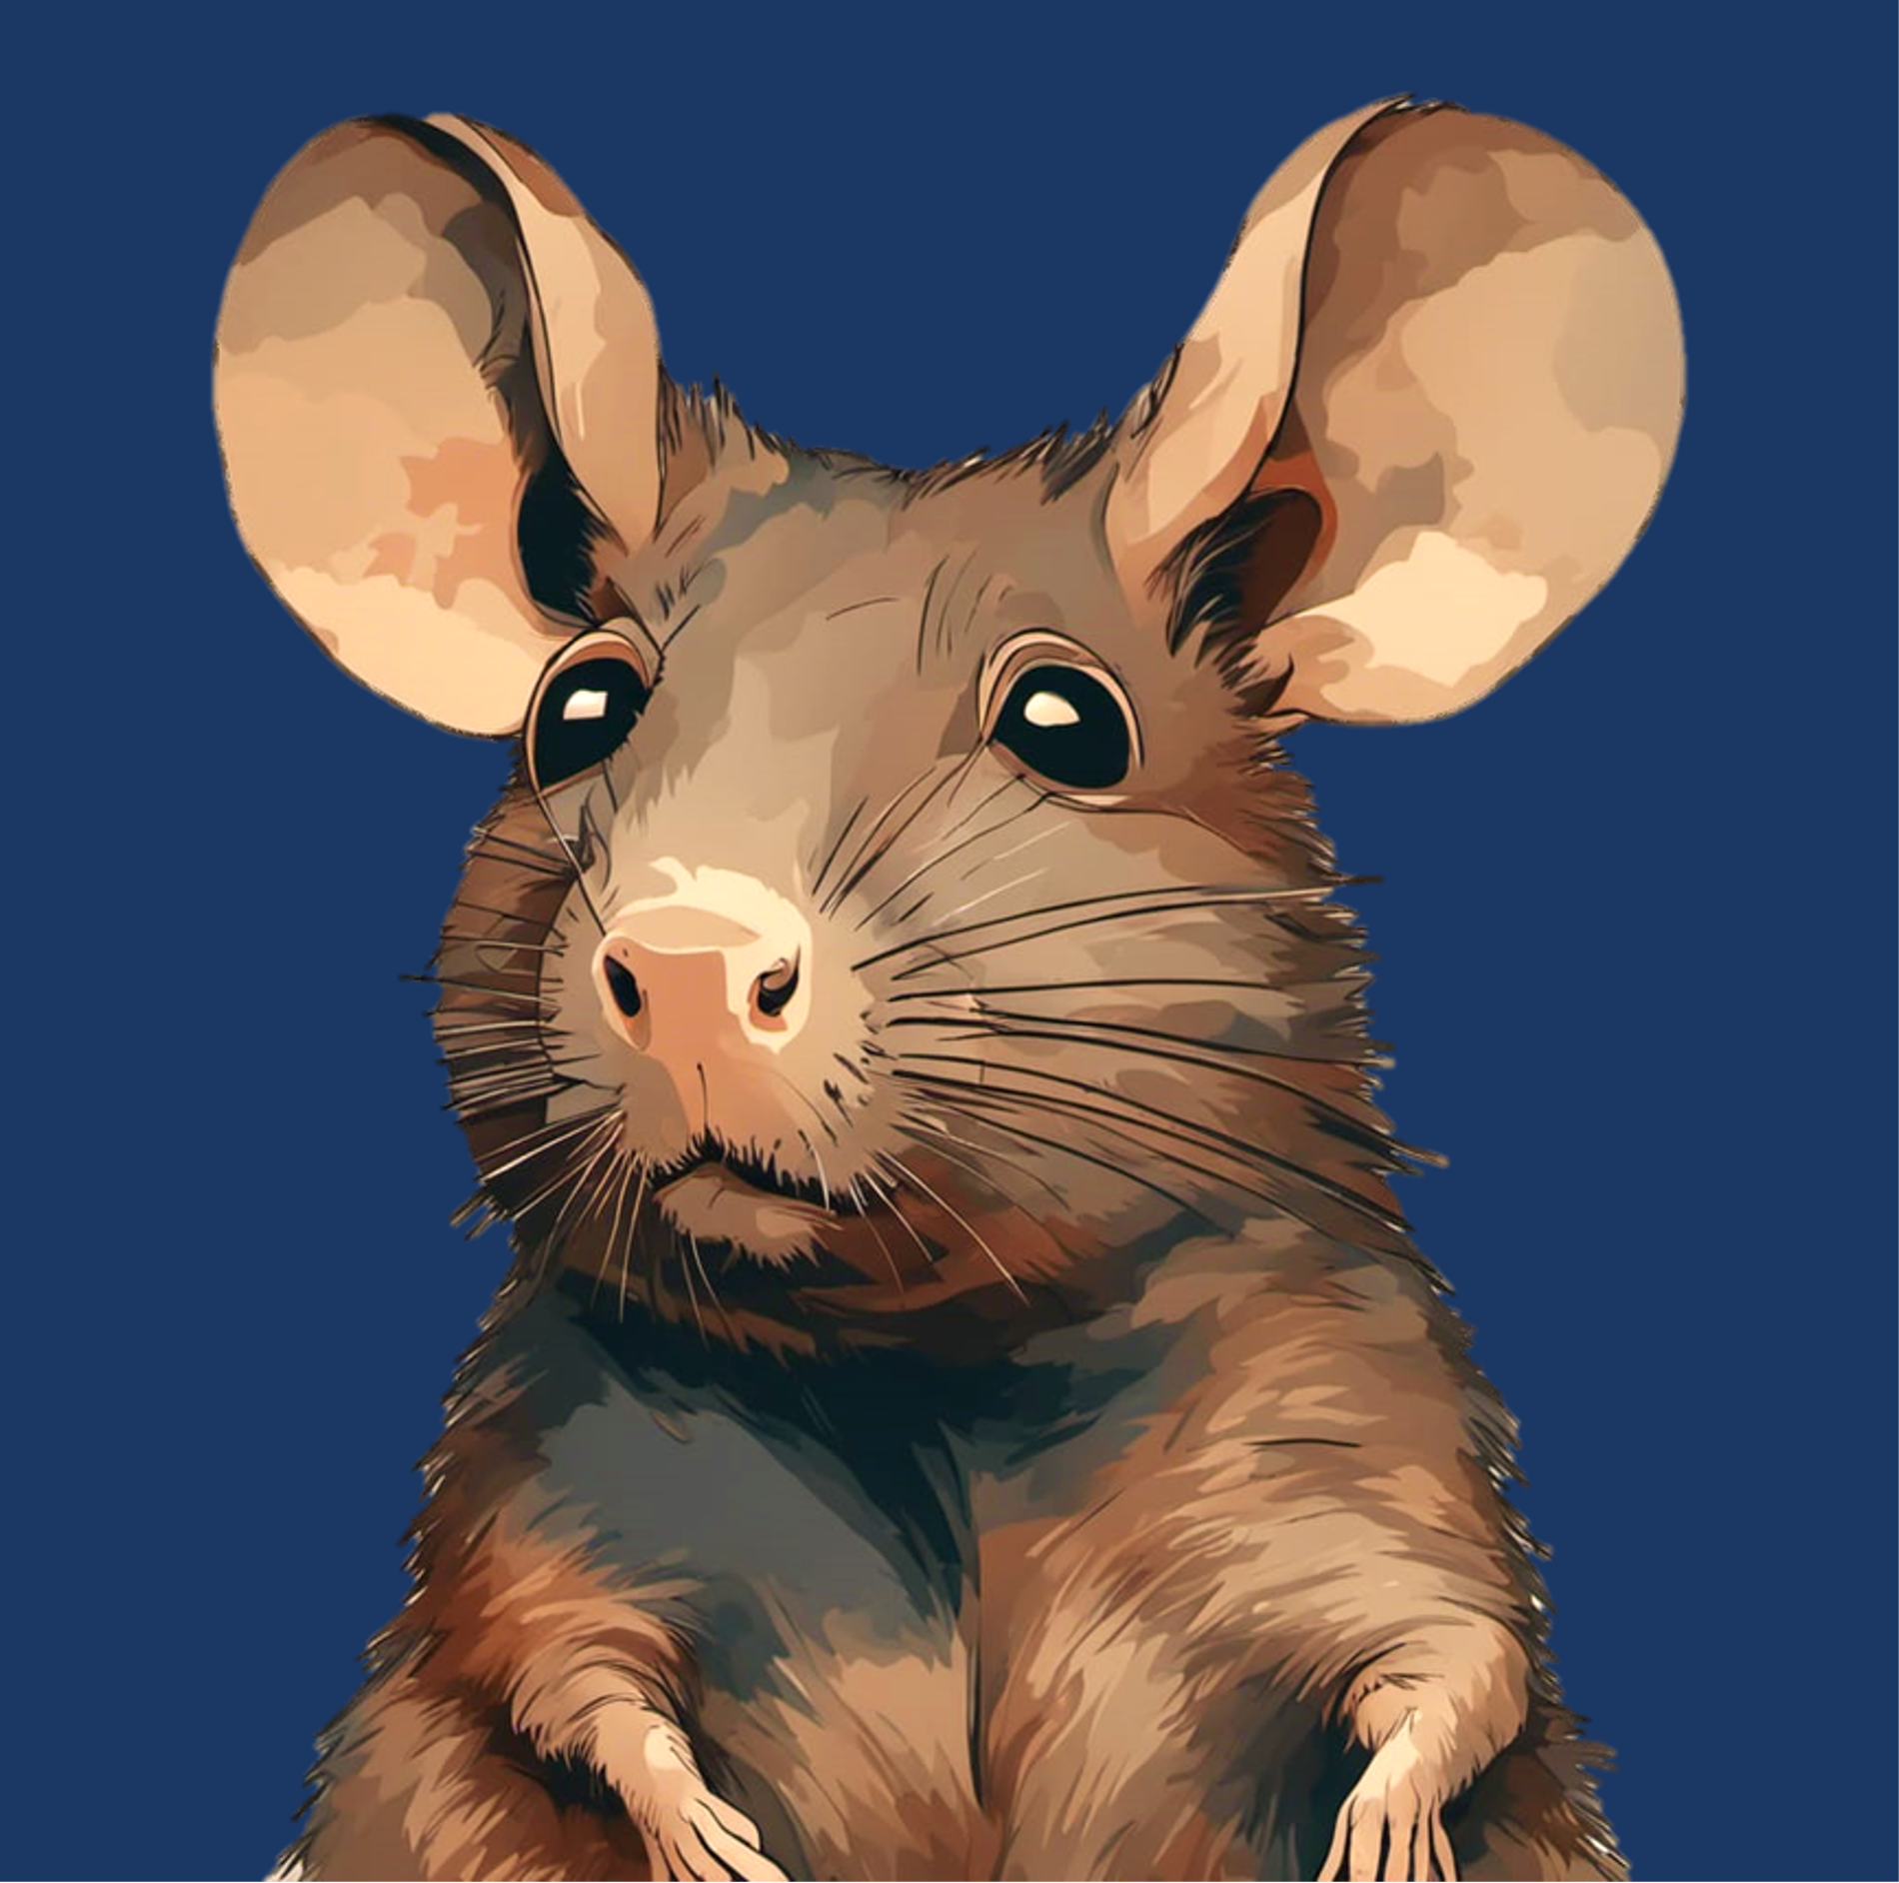



Slide 5
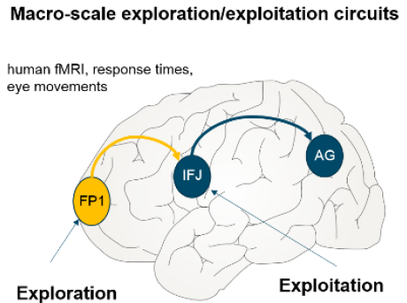
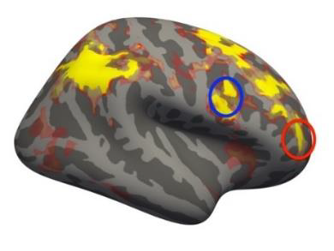

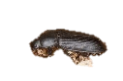



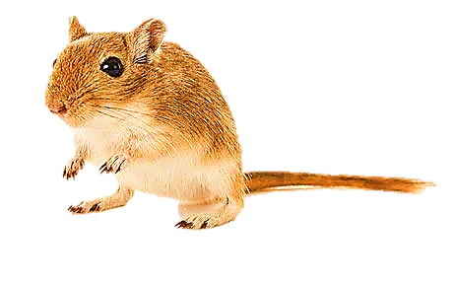
Background
Neural substrates for exploratory behaviour
Frontopolar cortex in humans – Gambling studies (Daw et al., 2006 ) (Raja Beharelle et al., 2015)
aPFC in Monkeys (Mansouri et al., 2015)
The Situation
Frontal region A (FrA) – analogous to Frontopolar cortex
Exploitation
Exploration
(Shuai and Song, 2011)
Notes:
We often must choose whether to try something new (exploration) or stick with a proven strategy (exploitation). Balancing this trade-off is important for survival and growth across species because, without exploration, we would perseverate with the same strategies and never discover better options. Which brain mechanisms are responsible for our ability to make these decisions?
Humans are remarkably curious, and that is useful in helping us to learn about new environments and possibilities. But curiosity killed the cat, they say, and it also carries with it substantial potential risks and costs for us. Statisticians, engineers and economists have long considered ways of balancing the costs and benefits of exploration.

Slide 6
Objective
To obtain insights into different neuronal circuit functions in the frontal cortex that contribute to optimal selection of exploitative versus explorative search strategies.
Ramping in overall activity of FrA before patch-leaving decision
Investigate if allocation of exploration or exploitation strategies differentially orchestrates the FrA circuitry in a layer-dependent manner

Slide 7
Objective
To obtain insights into different neuronal circuit functions in the frontal cortex that contribute to optimal selection of exploitative versus explorative search strategies.
Ramping in overall activity of FrA before patch-leaving decision
Investigate if allocation of exploration or exploitation strategies differentially orchestrates the FrA circuitry in a layer-dependent manner

Slide 8
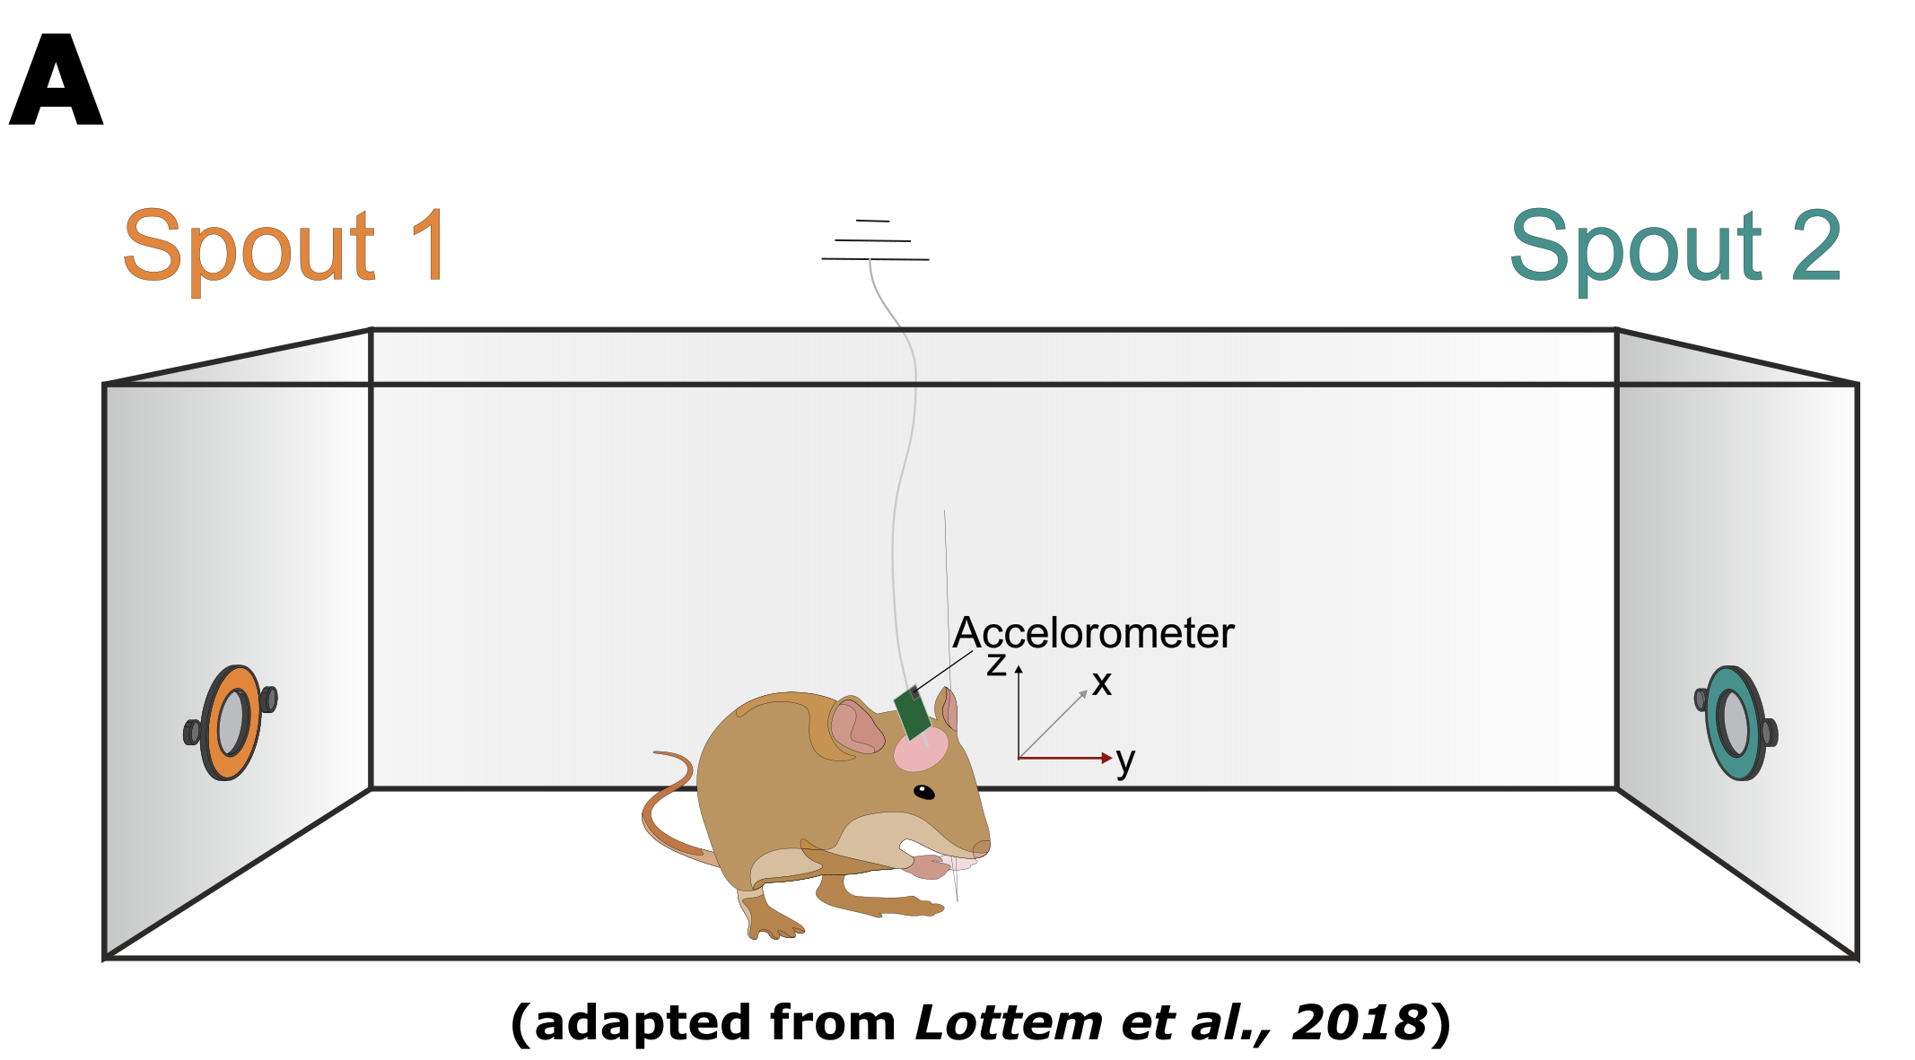
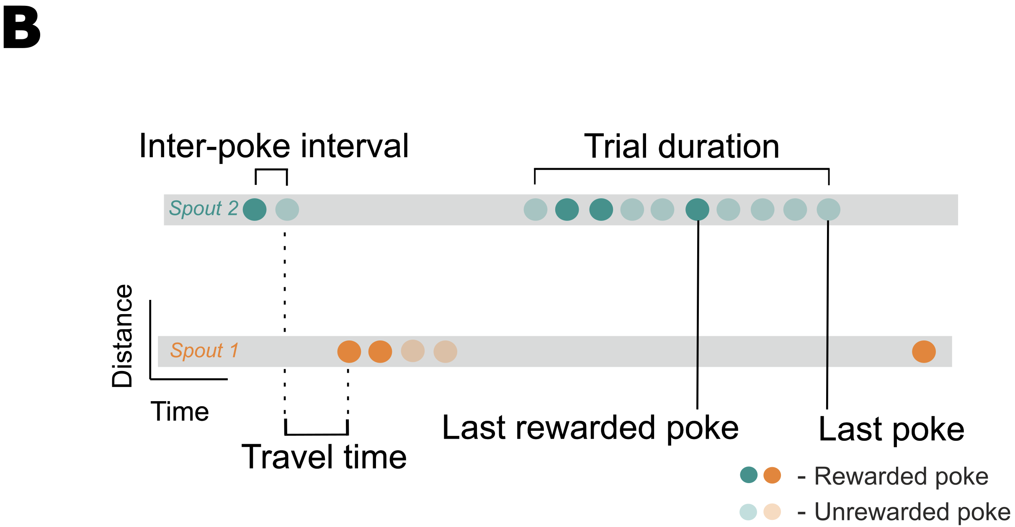
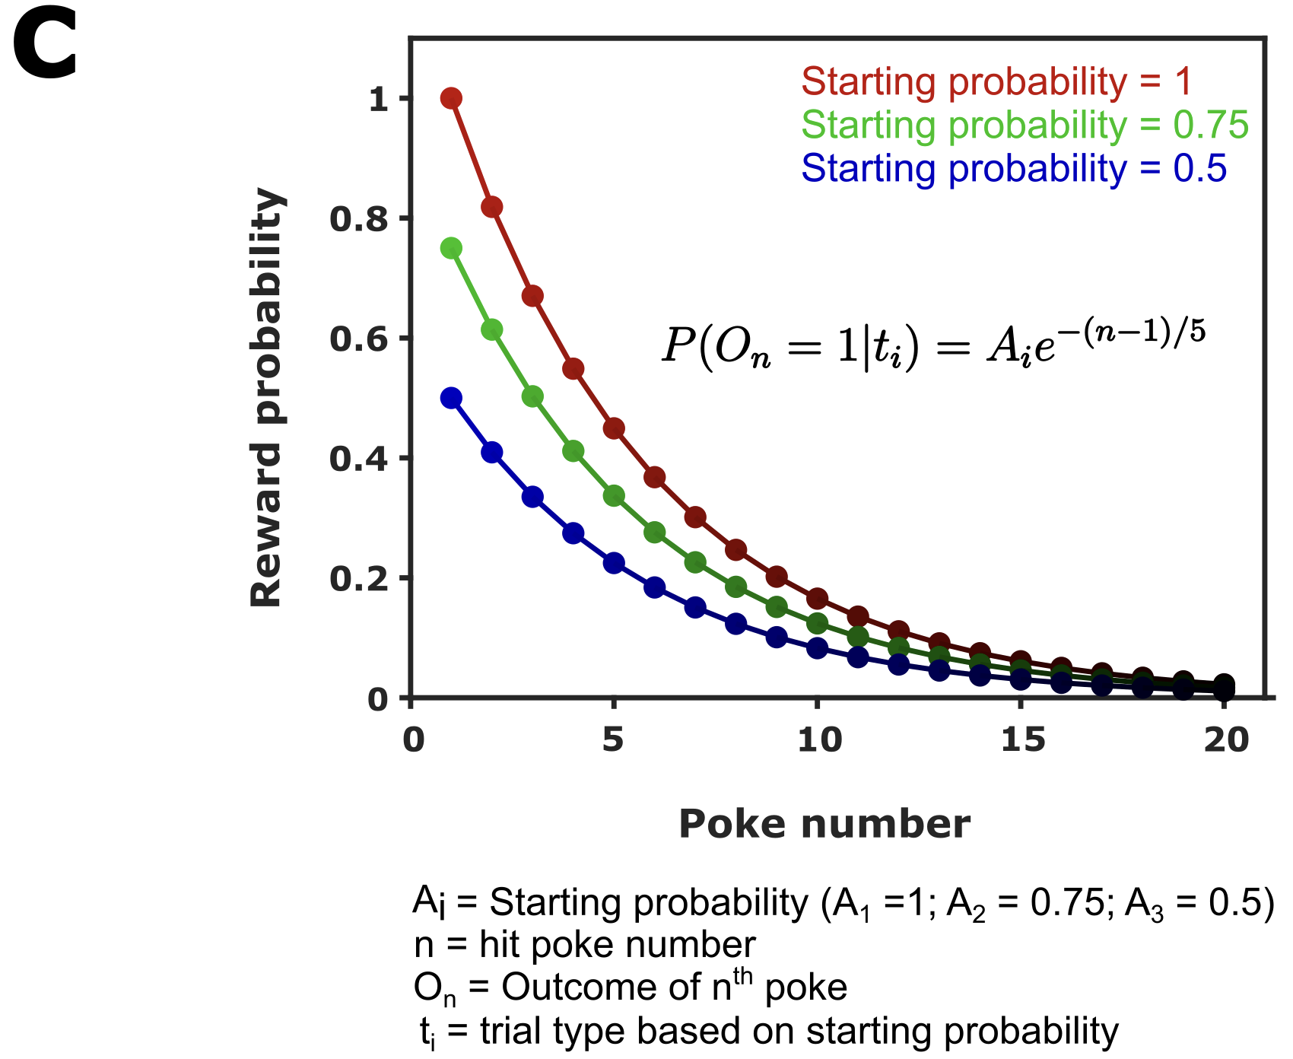
The probabilistic foraging task
?

Slide 9
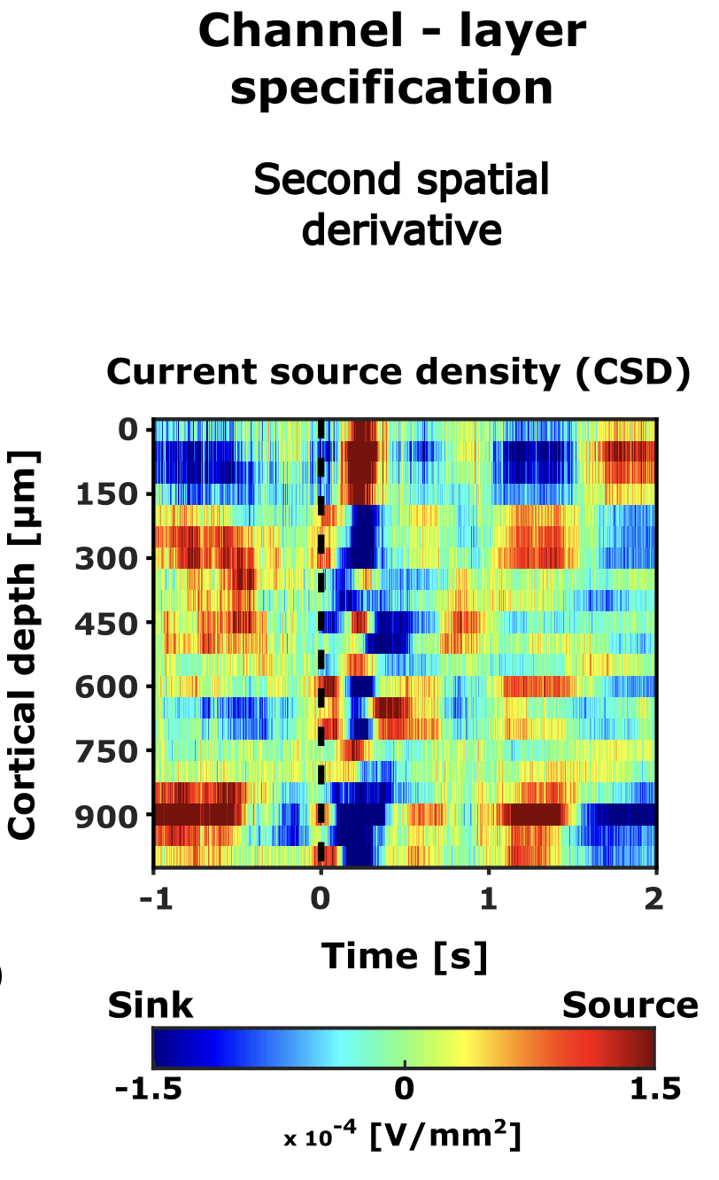
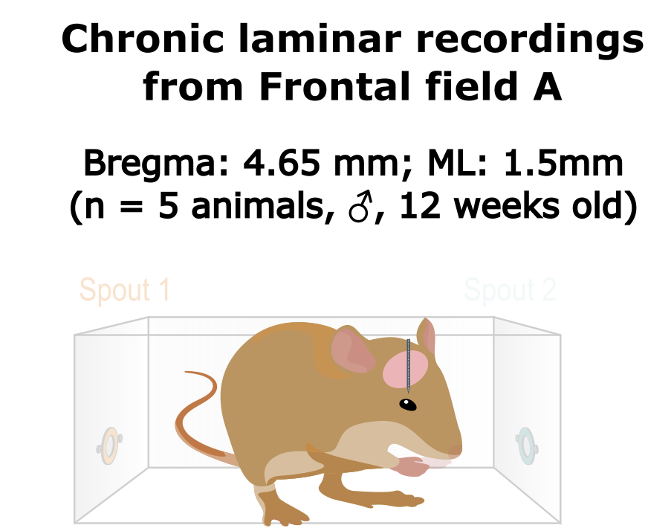
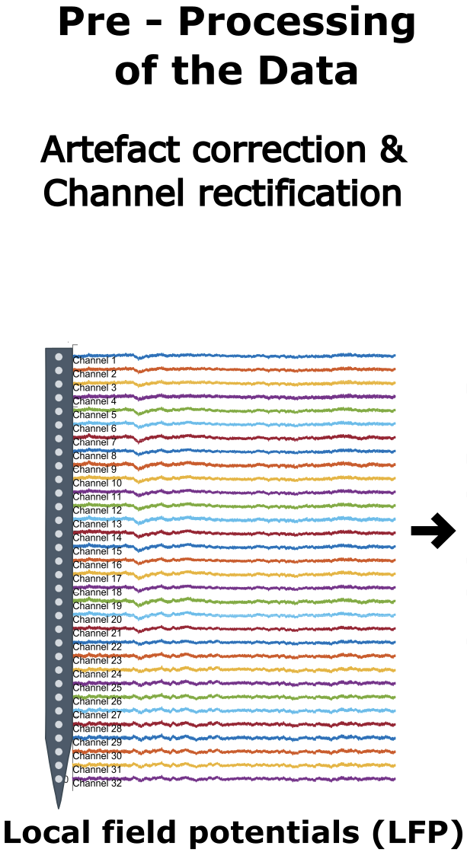
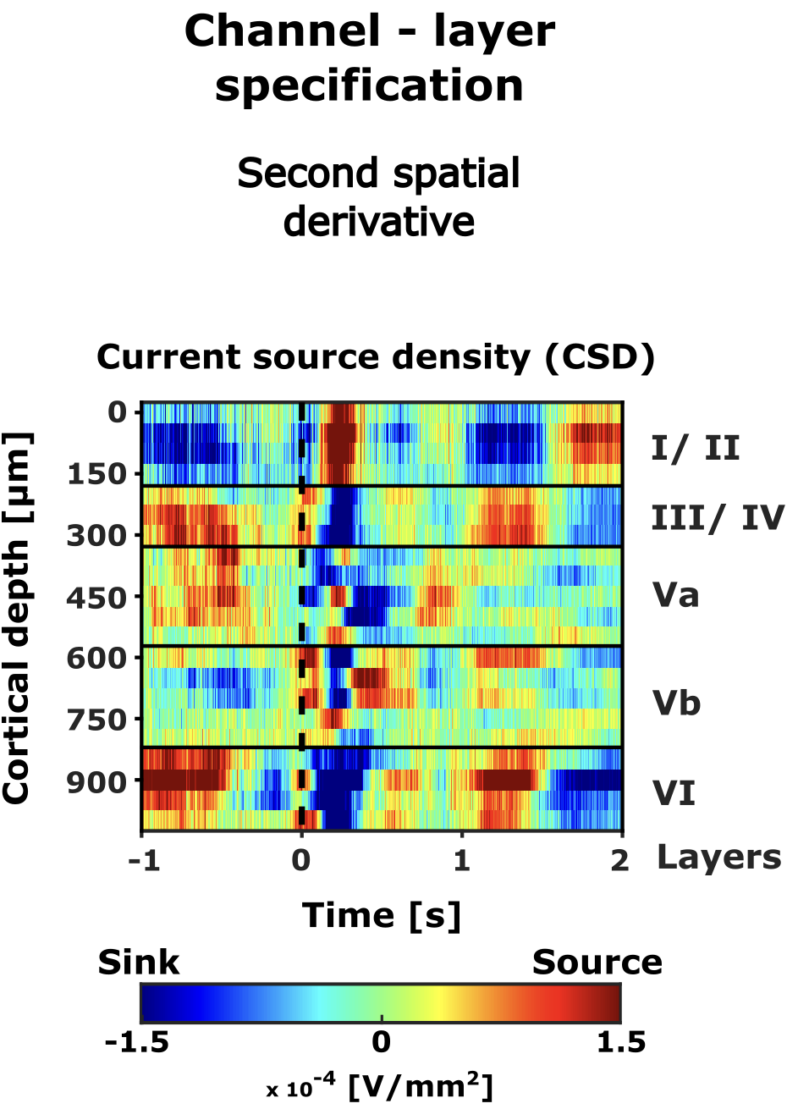
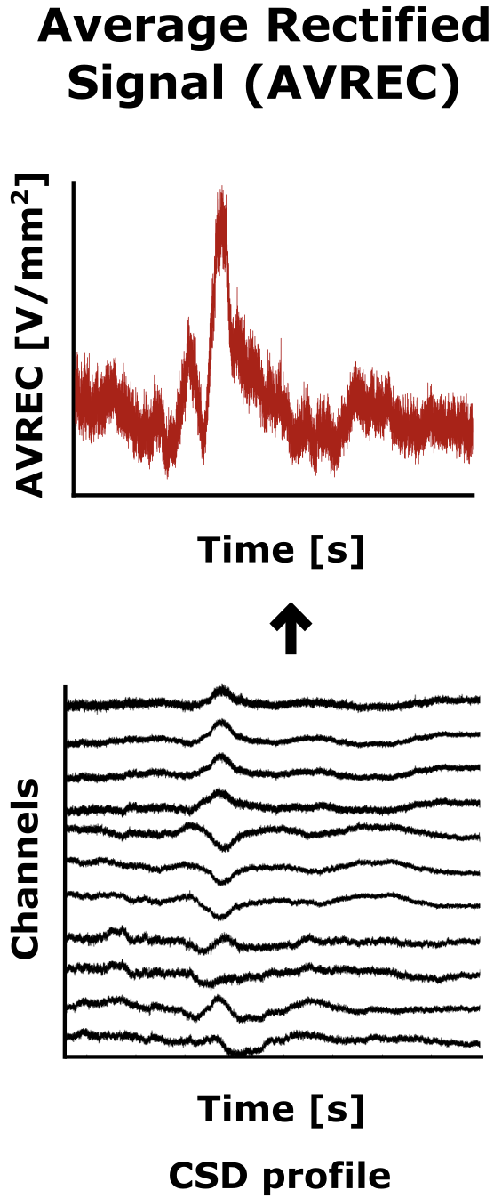

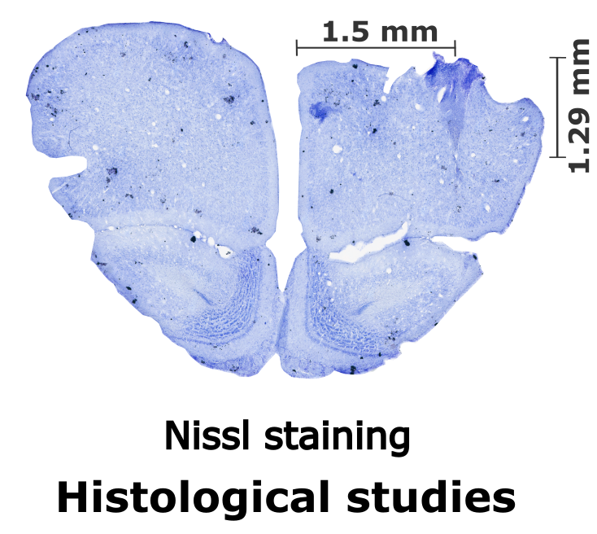
How do we study this?

Slide 10
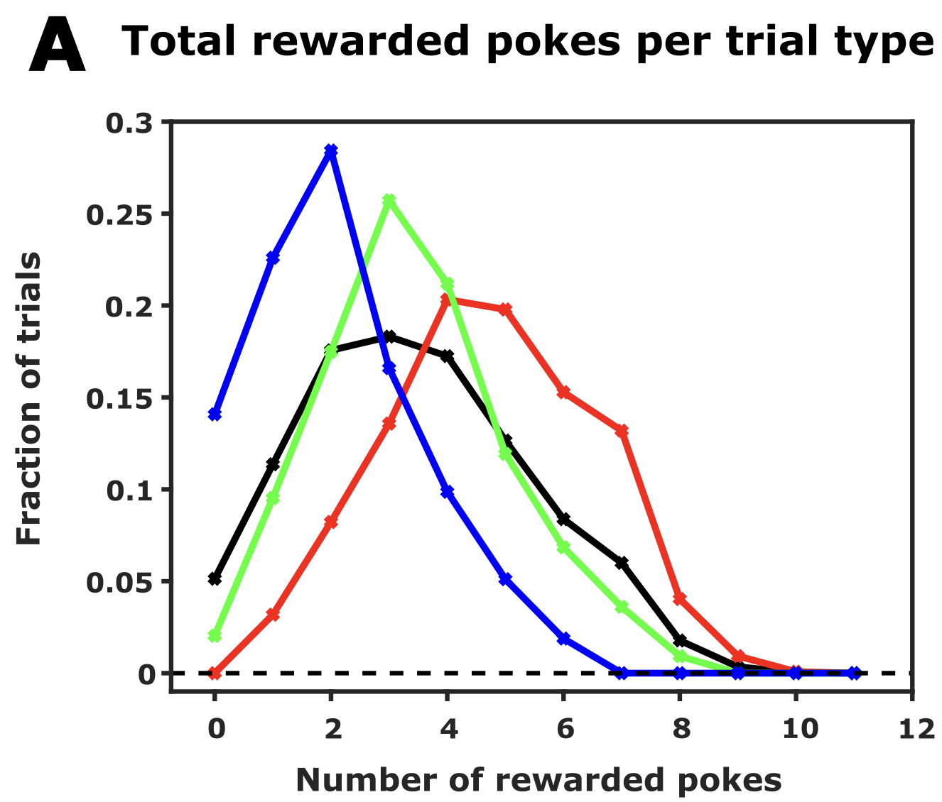
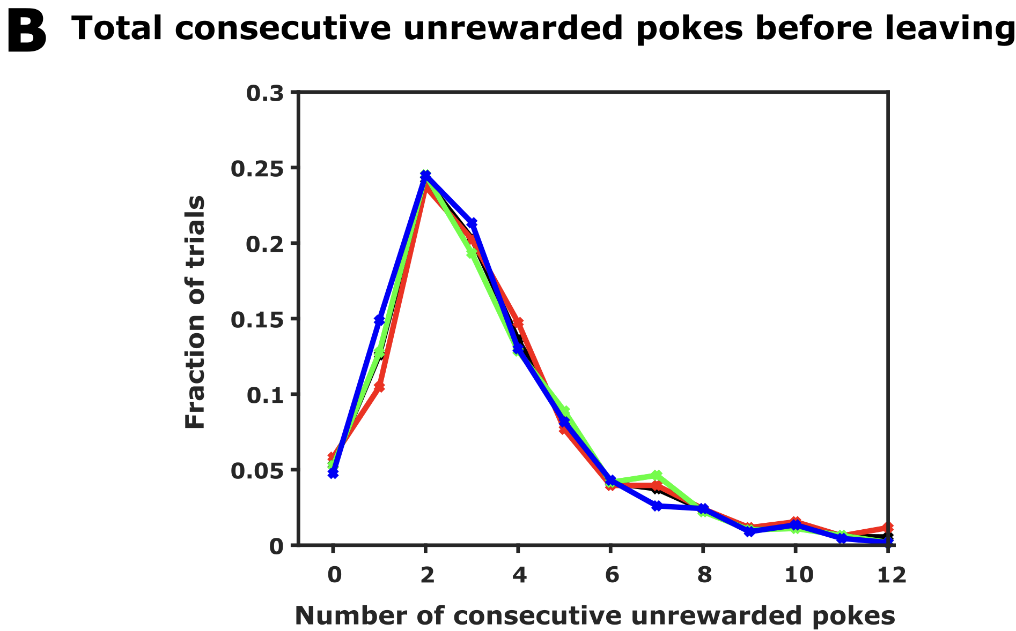
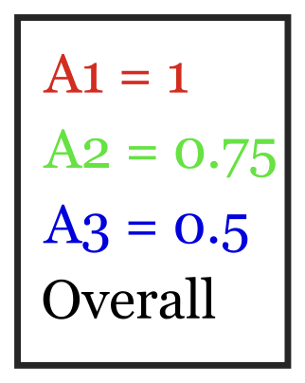
Animals make inference-based decision
How does the animal behave?
Number of consecutive unrewarded pokes before leaving is independent
of starting reward probability and total number of rewards received in a trial.

Slide 11
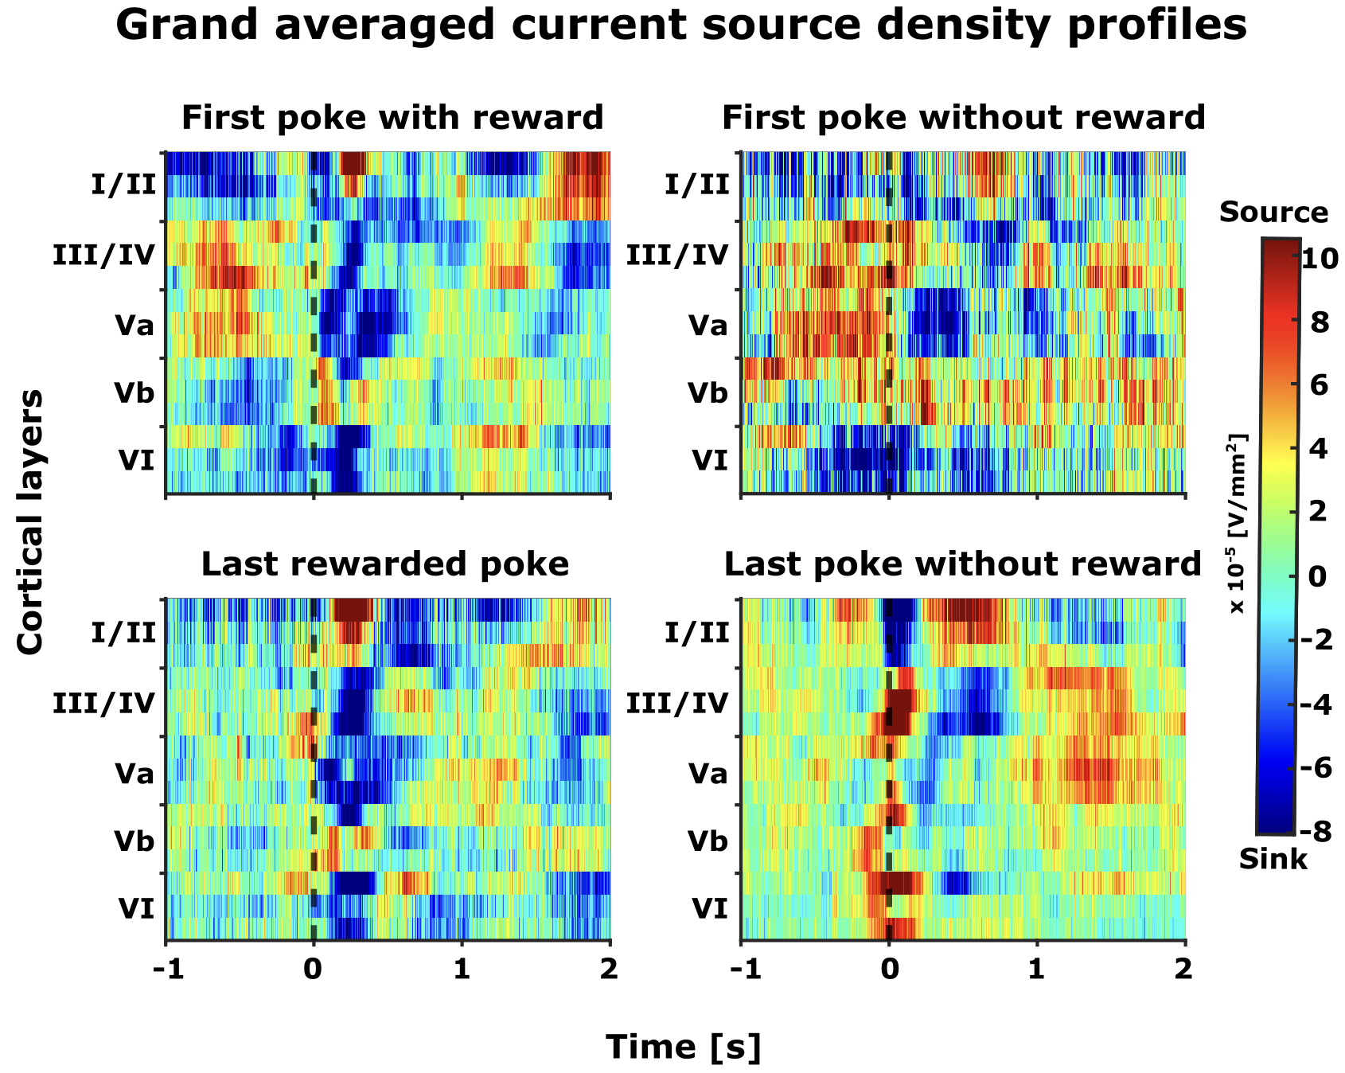
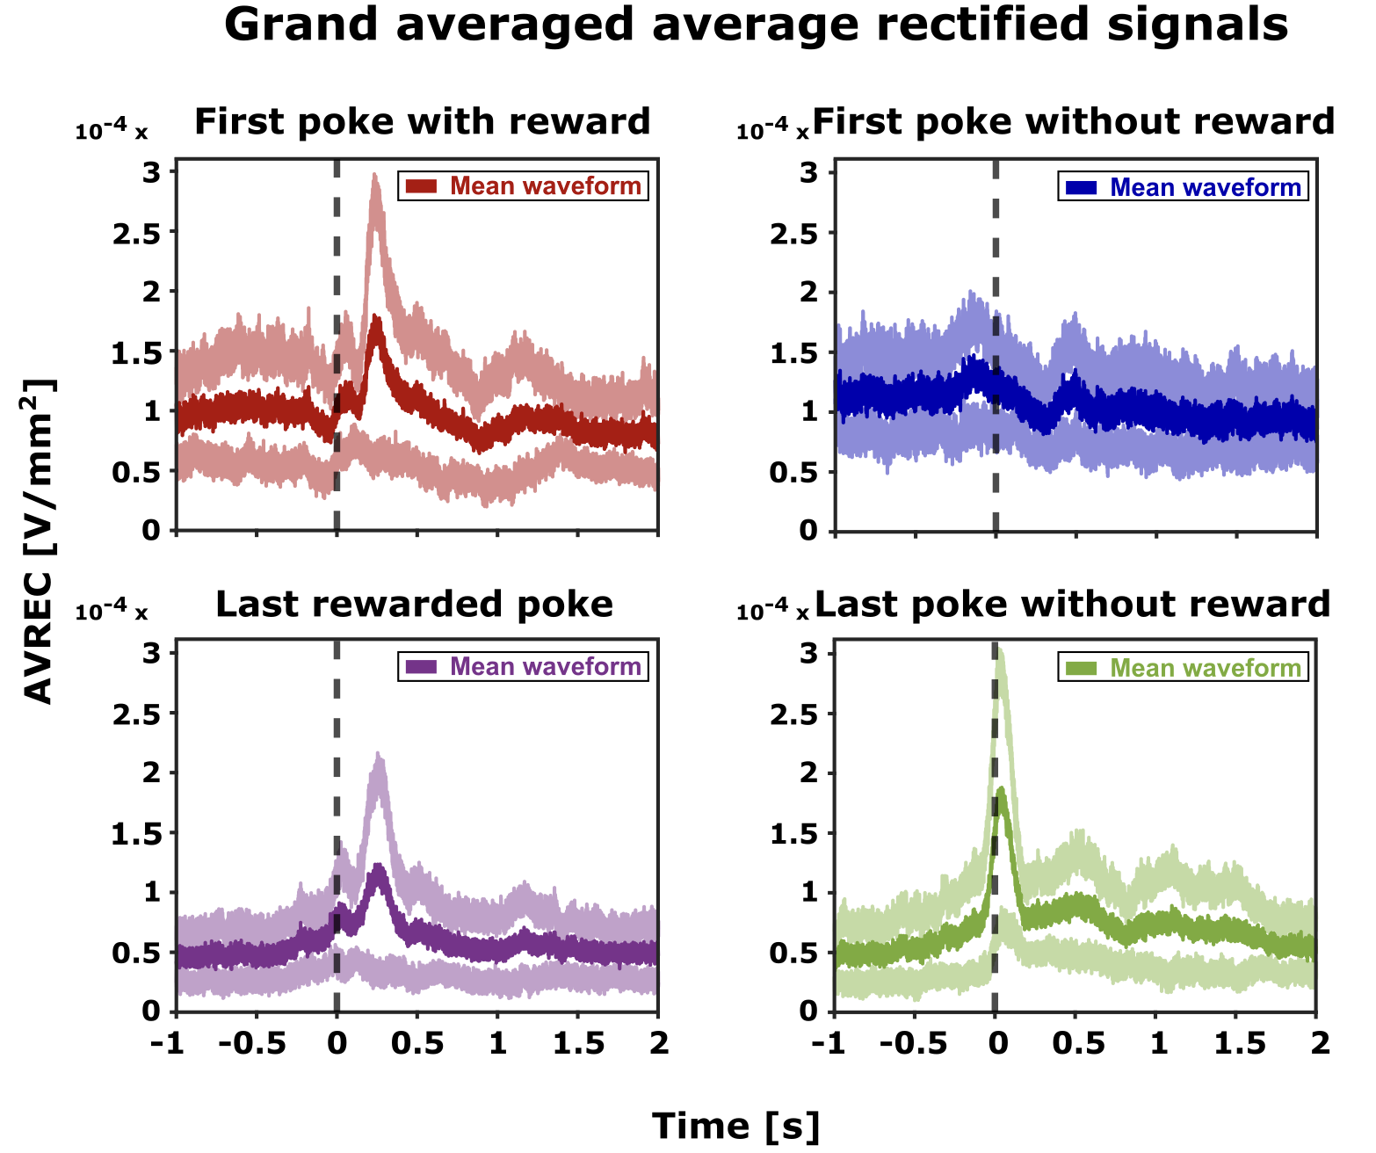
Distinct motor and reward related frontal activity

Slide 12
Distinct motor and reward related frontal activity

Slide 13
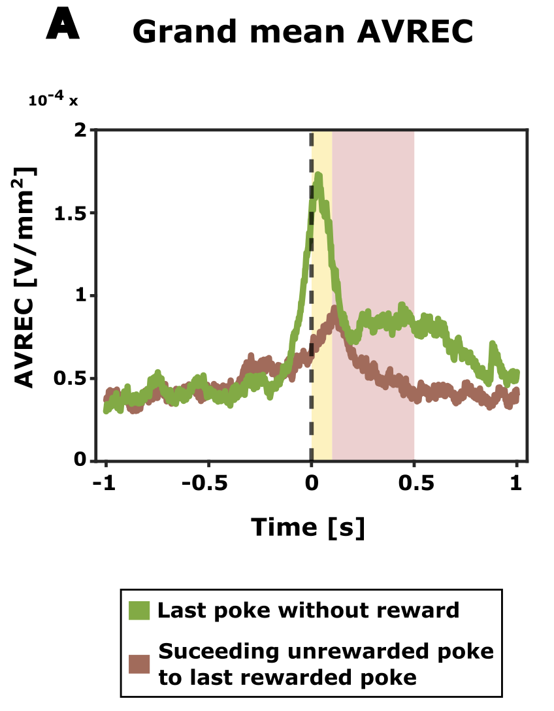
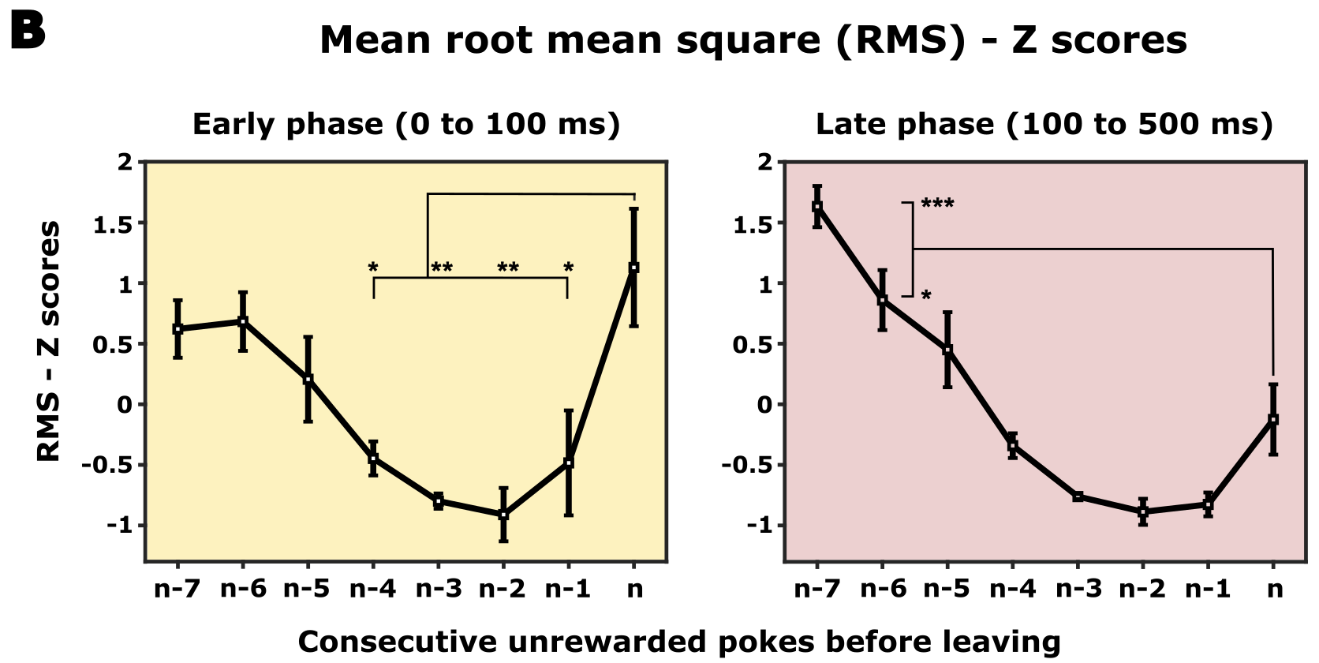

Shifts in frontal activity patterns: Exploitation to exploration
What makes the last poke the last one?

Slide 14
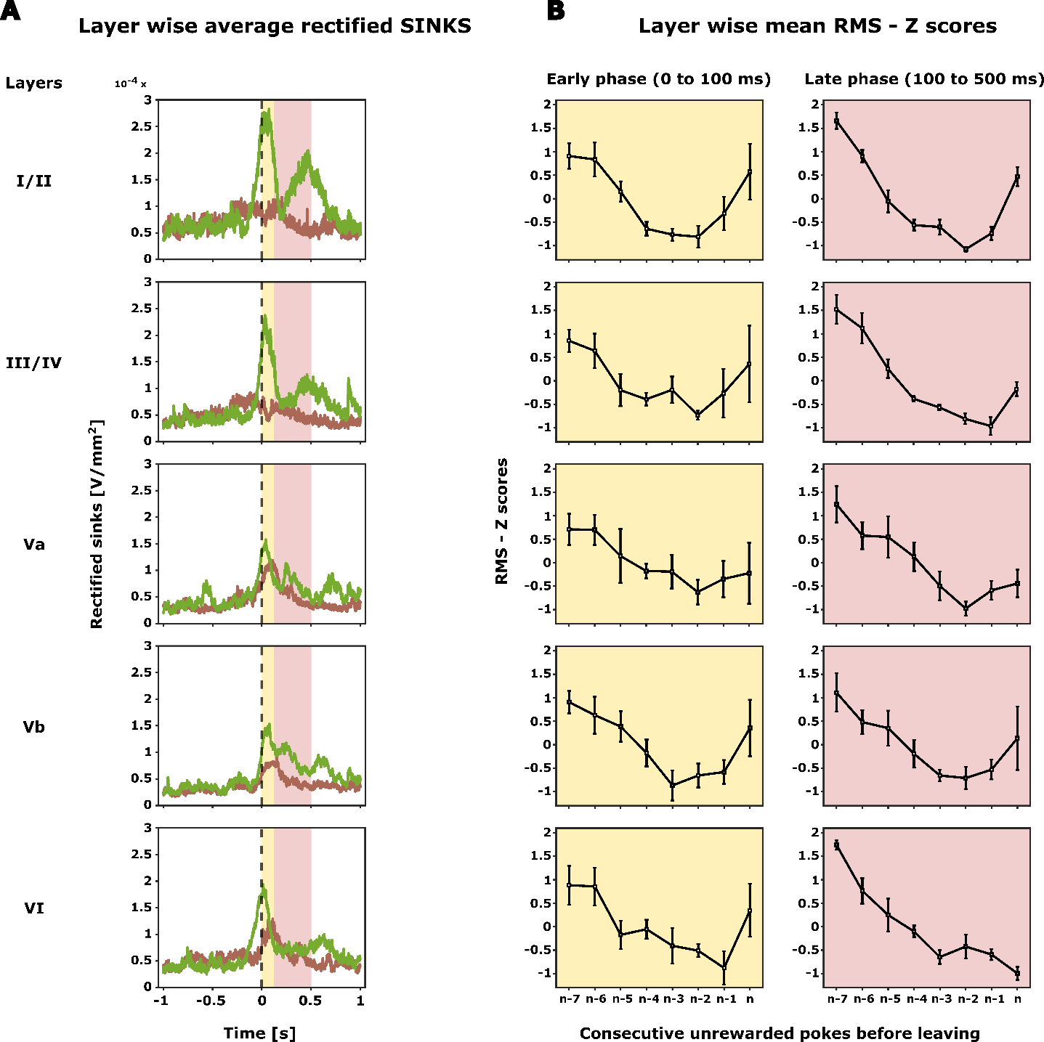
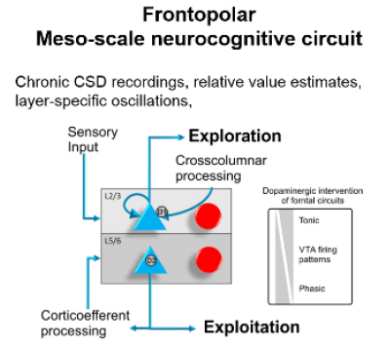
Layer specific frontal motor and reward related activity

Slide 15
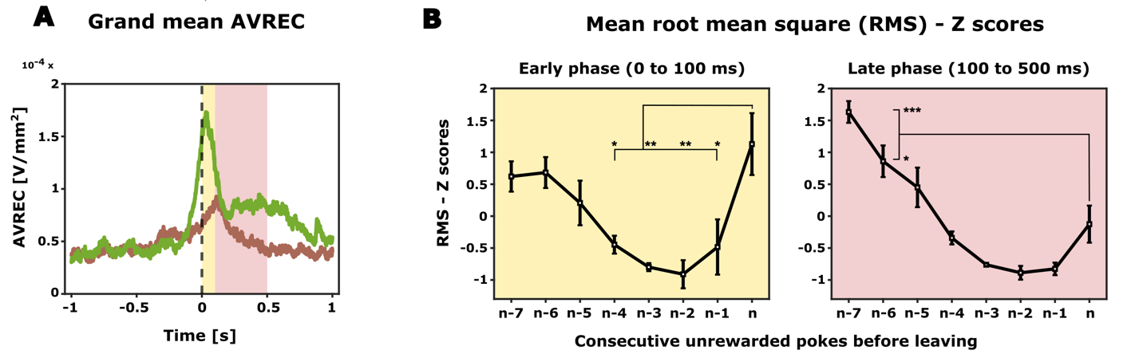
Summary
Probabilistic foraging
Animals make inference based decision
Increase in overall frontal activity just before the animal decides to explore
Cortical layers in frontal cortex seem to play a decisive role by altering current expectation and adopting adequate search strategies
To investigate the role of frontal cortex in exploration/exploitation dilemma and attentional resource allocation.

Slide 16
Future directions
Reinforcement Learning Modeling can help to investigate the trial-by-trial parameters, that underlie animal's inference-bound adaptive decision-making behavior, providing insights into the neural circuitry of attentional resource allocation
Optogenetic intervention to understand the causal relationship
In a comparative foraging task in humans using high-field fMRI, we plan to observe if similar layer-specific functions during exploration/exploitation transitions can be demonstrated.

Slide 17
Why this lab?

Slide 18
Thank you

Slide 19
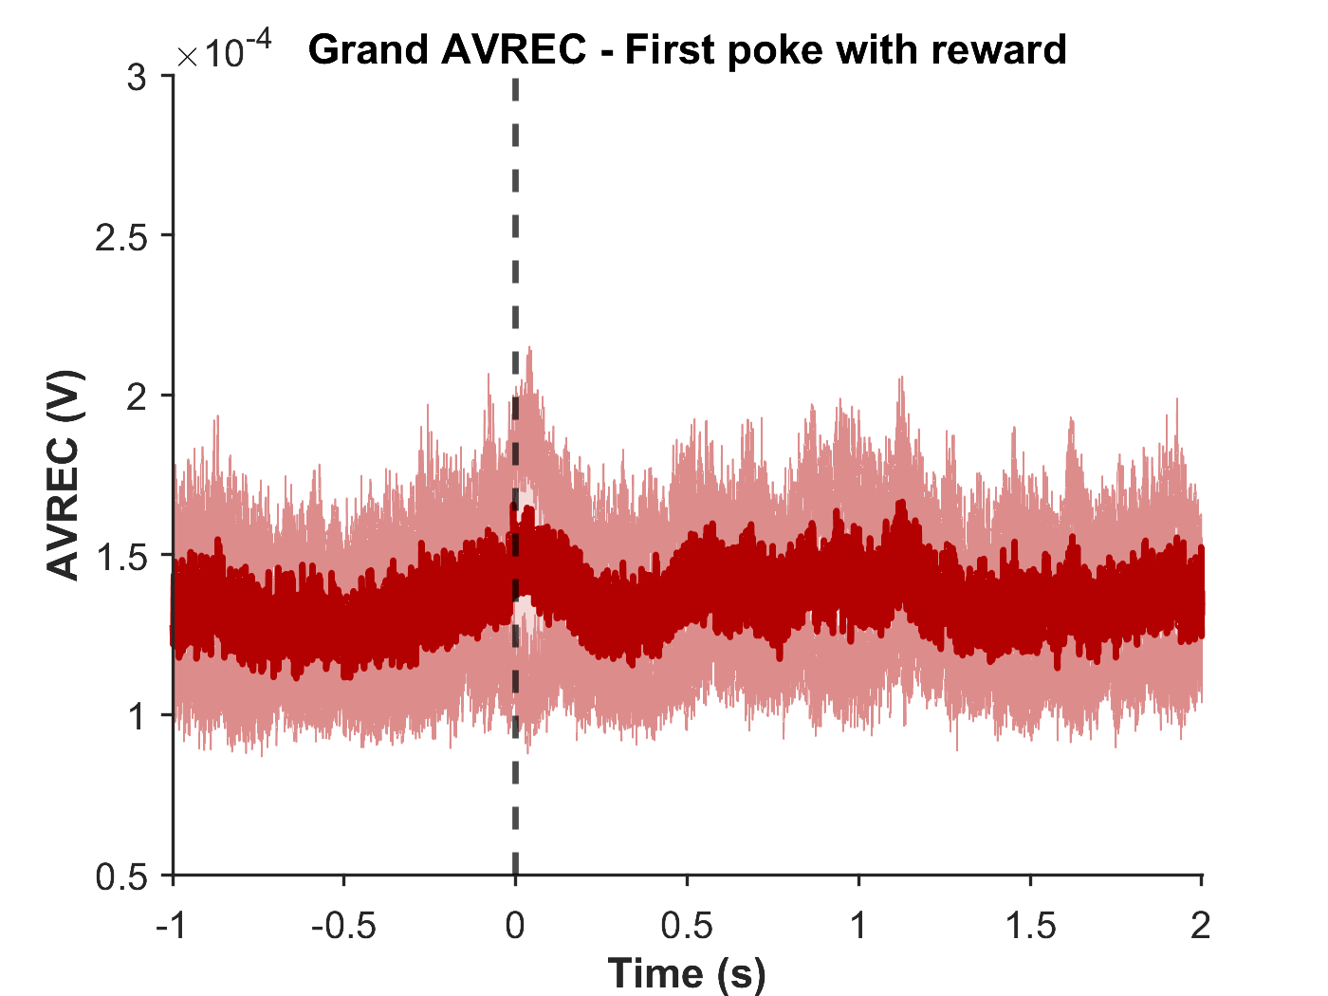
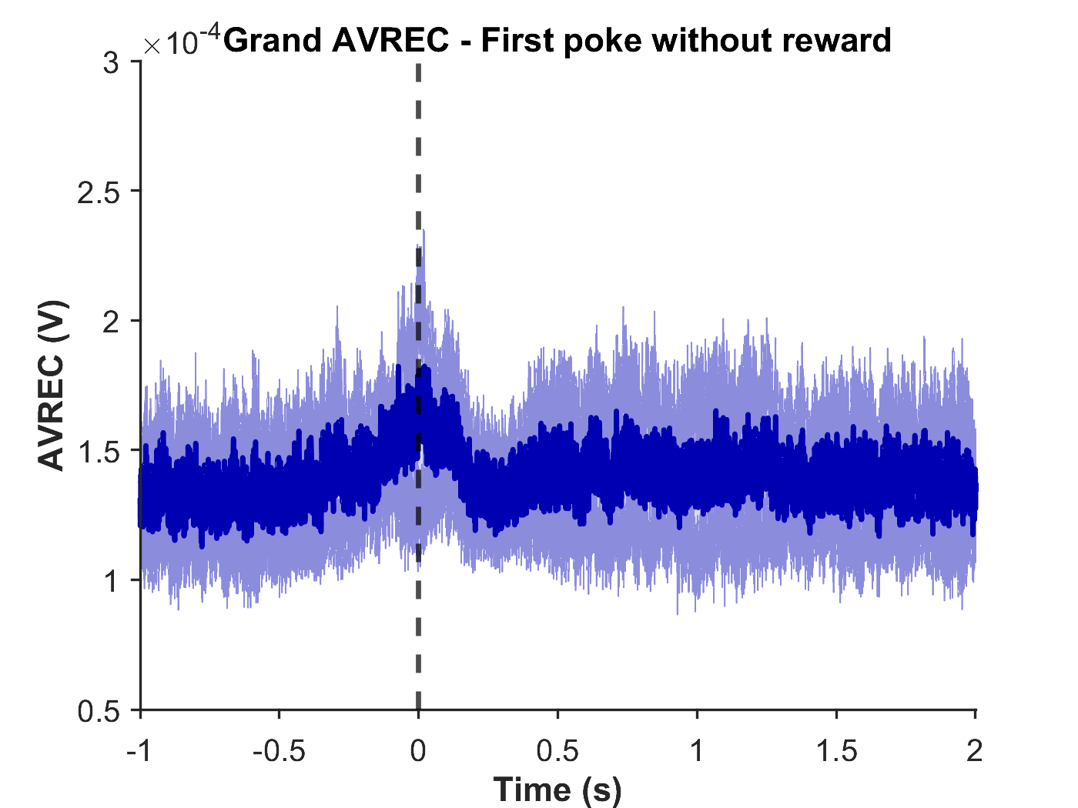
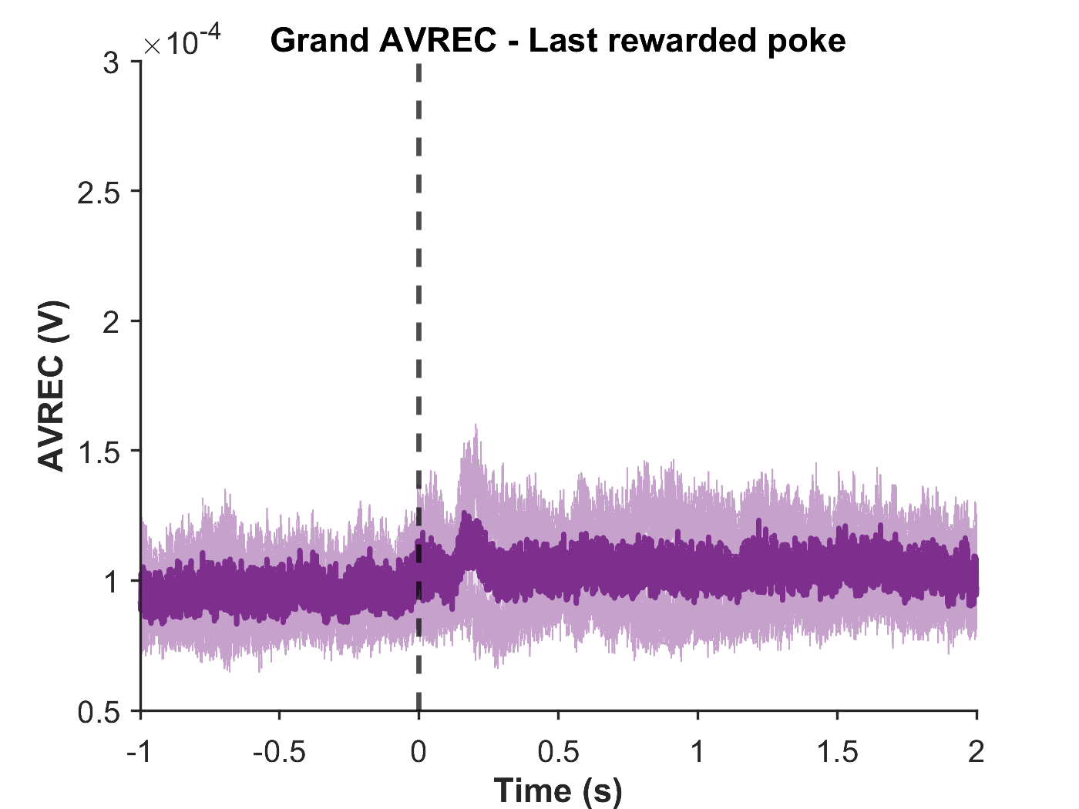
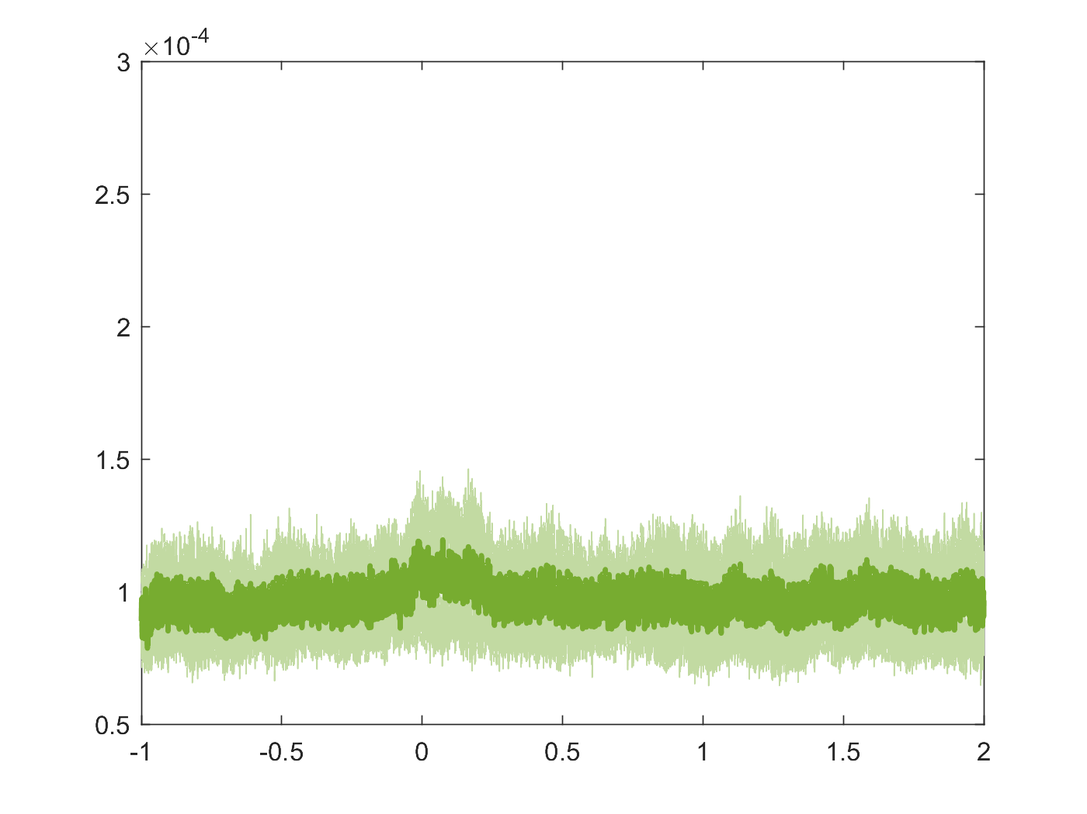
Signal from motor cortex
(4mm from bregma, motor cortex)
(4.65mm from bregma)

